Slide 1
Cancer ASK
Authors:-
Mirza Tanzim Sami¹, Nilesh Kumar², Trupesh Patel¹
Team name:
DeepBioComp
¹Department of Computer Science, UAB, ²Department of Biology, UAB
Presentation:-
Mirza Tanzim Sami,
Nilesh Kumar,
Trupesh Patel
Instructor:-
Dr. John Osborne

Slide 2
Introduction
Cancer Ask 🦀 is the only composite deep learning model for Cancer based question-answering task.
It leverages two state of the art NLP based deep learning model
BioBERT
GPT2
Cancer Ask 🦀 brings powerful question-answering capabilities, producing answers which are semantically and contextually meaningful.
Answers can be short and sweet or verbose and comprehensive.

Slide 3
Motivation and Approach
Long Comprehensive Answer
Why?
Fine-tuned on cancer dataset provided by MedQuAD dataset¹
Give short answers
Produce context rich, comprehensive answers
GPT2
Short Answer
BioBERT
Question from User
Ref¹: https://arxiv.org/abs/1901.08079

Slide 4
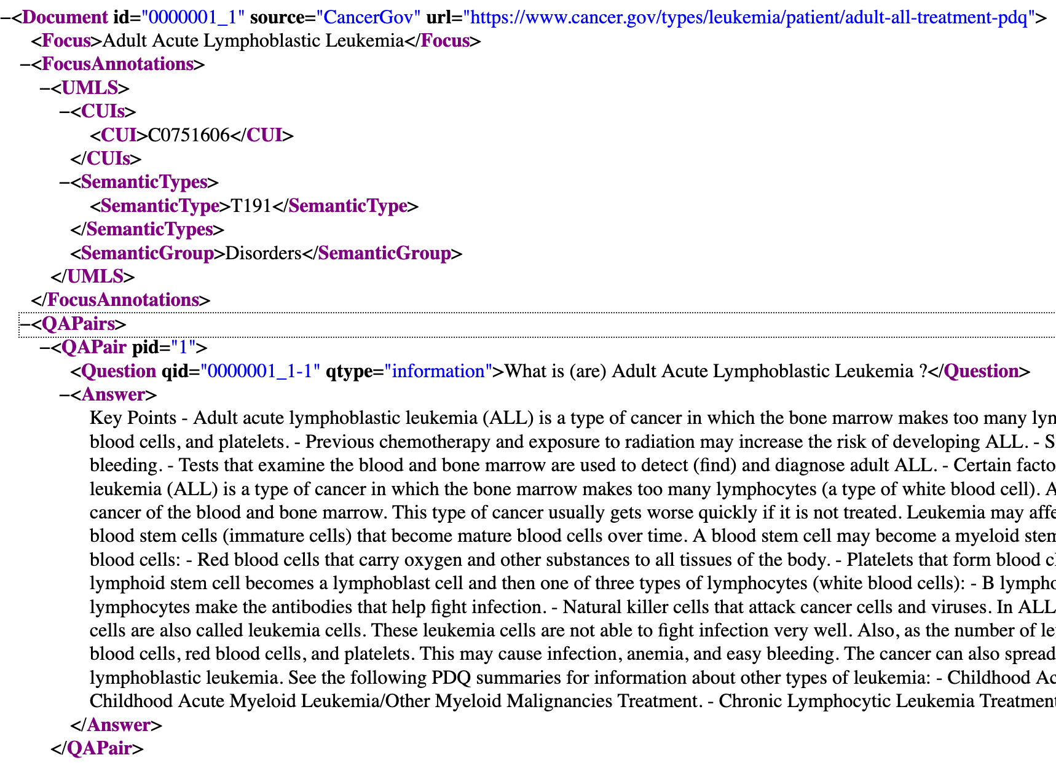
Dataset
Cancer dataset, published as MedQuAD¹
Created for medical question-answering
12 NIH websites (e.g. cancer.gov, niddk.nih.gov, GARD, MedlinePlus Health Topics)
Focused on ~100 types of cancers
In total 729 questions
12 different type of questions

Slide 5
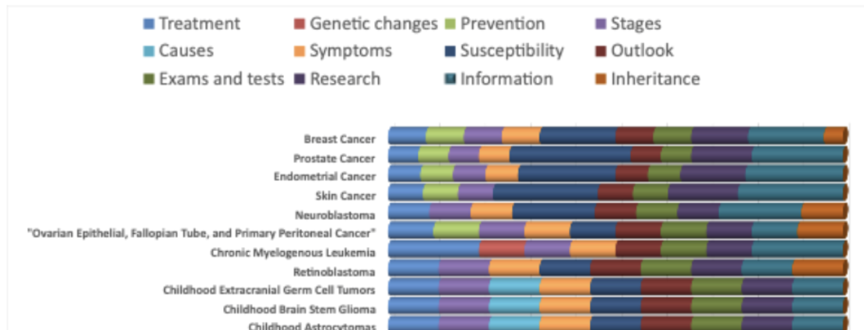
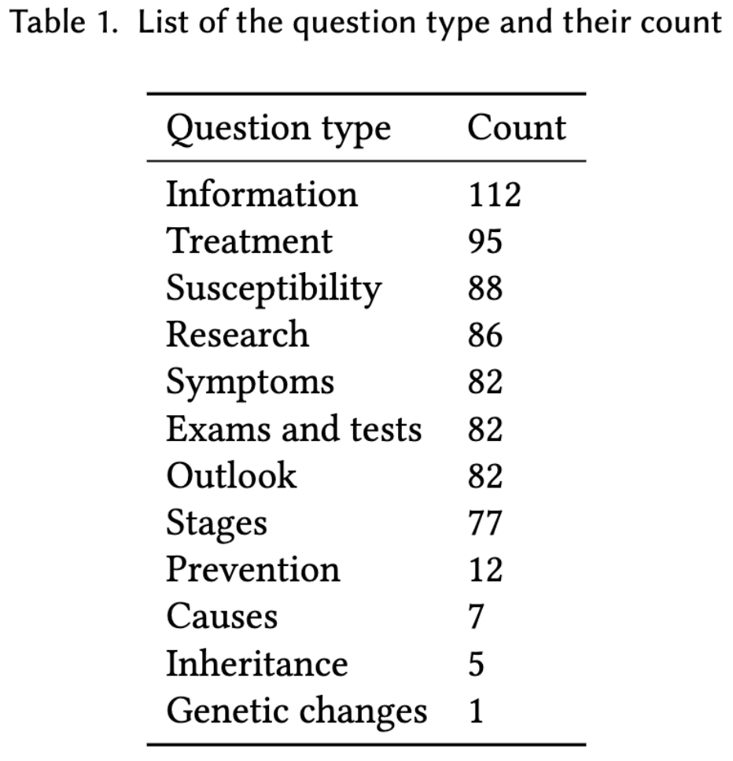
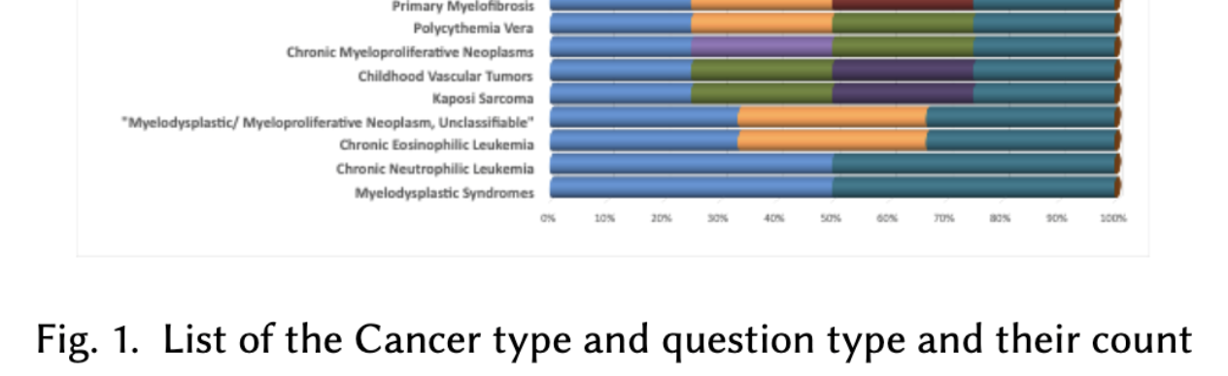
Dataset
…

Slide 6
Dataset Challenges
BioBERT model require tags:
Context
Question
Answer
Start_answer
Missing tags in raw data:
Context
Start_answer
Data modification steps:
Answer (XML tag) → Context (JSON key)
Context (JSON key) to short and correct Answer (JSON key)
Calculate Start_answer (JSON Key) index from Context (JSON key)

Slide 7
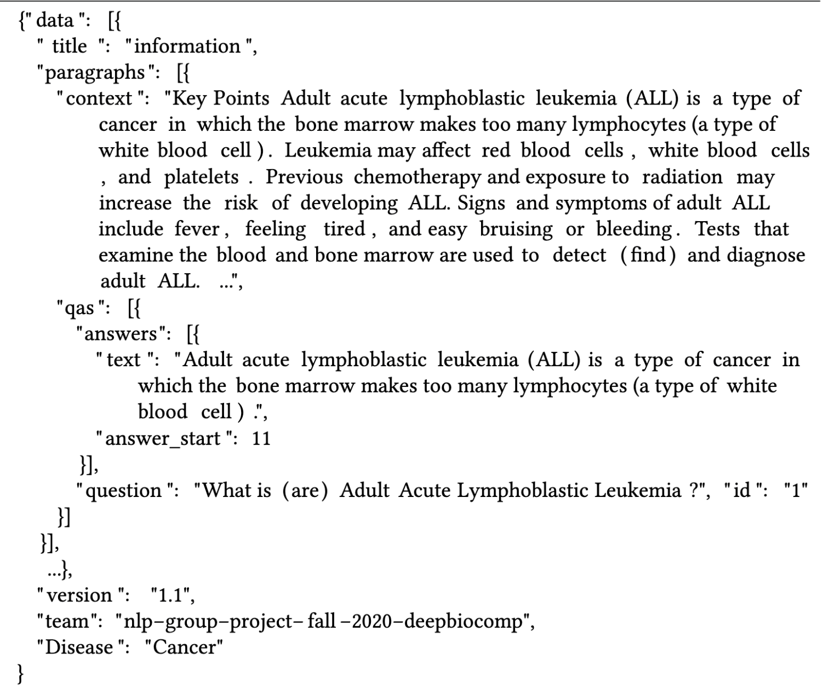
Dataset challenge
Before
After

Slide 8
BioBERT
A variant of the BERT model.
BioBERT comes fine-tuned on the PubMed dataset.
Fine-tuned again on MedQuAD dataset to make more precise toward cancer specific QA.
The script is modified from the ‘run_squad.py’ script from Huggingface’s Transformer².
Ref²: https://github.com/huggingface/transformers/blob/master/examples/question-answering/run_squad.py

Slide 9
BioBERT
Fine – tuned parameter:
"model_name_or_path": 'dmis-lab/biobert-base-cased-v1.1-squad’ ,
"learning_rate": 5e-5 ,
"num_train_epochs": 20 ,
"max_seq_length": 384 ,
"doc_stride": 128 ,
"per_gpu_eval_batch_size": 12 ,
"per_gpu_train_batch_size": 12 ,
"save_steps": 5000,
"do_lower_case": True,
Ref²: https://github.com/huggingface/transformers/blob/master/examples/question-answering/run_squad.py

Slide 10
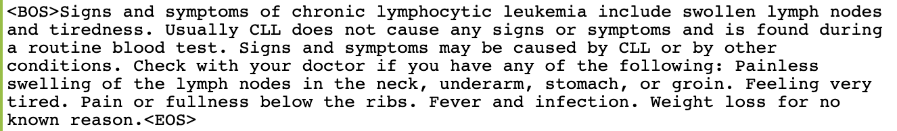
GPT2
Unsupervised model
Uses only Context from the dataset
Every sentence
<BOS> (beginning of sentence) tag
<EOS> (end of sentence) tag
The script is modified from the ‘run_language_modelling.py’ script from Huggingface’s Transformer git repo.

Slide 11
GPT2
Fine – tuned parameter:
"model_name_or_path": ‘gpt2’ ,
"learning_rate": 5e-5 ,
"num_train_epochs": 20 ,
"per_gpu_eval_batch_size": 1 ,
"per_gpu_train_batch_size": 1 ,
"save_steps": 100,
"eval_steps": 100
"line_by_line": true

Slide 12
Composite Model
Long Comprehensive Answer
The BioBERT model returns an answer for the given query, the output is used as the input for the GPT2 model.
The text-generation code is based on the ‘run_generation.py’ script from the Huggingface’s Transformer git repository.
The script has been completely modified and rewritten as a python function in a Jupyter notebook. It has also been modified to accept our dataset which contains the ‘<BOS>’ and ‘<EOS>’ special tokens.
Thus the model provides a detailed answer to cancer related queries submitted by user.
GPT2
Short Answer
BioBERT
Question from User

Slide 13
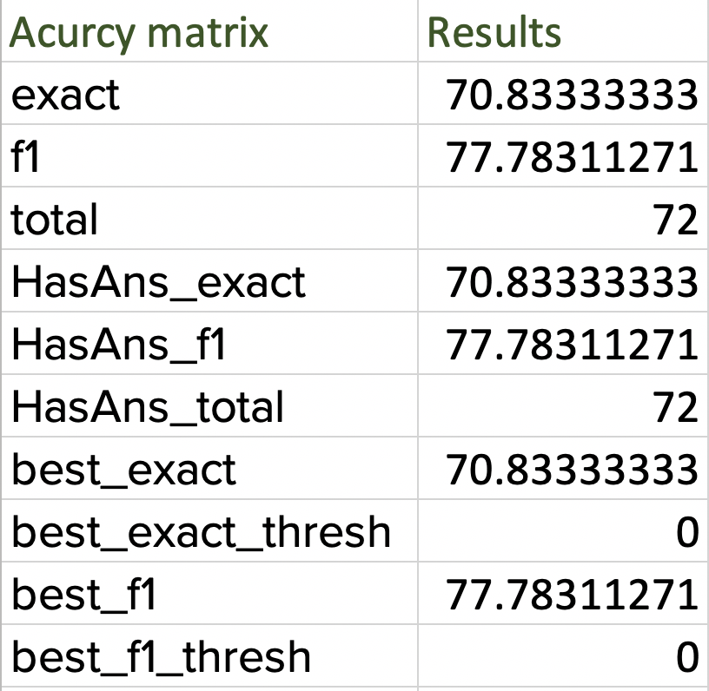

Accuracy Metrics
BioBERT Tuning:
GPT2 Tuning:

Slide 14
Qualitative Results
Example 1
Question: "What are the stages of Vulvar Cancer ?"
Short Answer: stage i stage ii stage iii stage iv after vulvar cancer has been diagnosed, tests are done to find out if cancer cells have spread within the vulva or to other parts of the body.
Long Answer: stage i stage ii stage iii stage iv after vulvar cancer has been diagnosed, tests are done to find out if cancer cells have spread within the vulva or to other parts of the body. The following stages are used for vulvar cancer: Stage I Stage II Stage III Stage IV Stage V After vulvar cancer has been diagnosed, tests are done to find out if cancer cells have spread within the vulva or to other parts of the body. The process used to find out if cancer has spread within the vulva or to other parts of the body is called staging. The information gathered from the staging process determines the stage of the disease. It is important to know the stage in order to plan treatment. Vulvar cancer in men may affect the risk of developing rectal cancer. Having rectal cancer during surgery can increase the risk of rectal cancer and is called a risk factor. Having rectal cancer in a first degree relative (parent, brother, or sister) increases the risk even more.

Slide 15
Qualitative Results
Example 2
Question: "What are the symptoms of the Ovarian Germ Cell Tumors ?"
Short Answer: signs of ovarian germ cell tumor are swelling of the abdomen or vaginal bleeding after menopause.
Long Answer: signs of ovarian germ cell tumor are swelling of the abdomen or vaginal bleeding after menopause. These and other signs and symptoms may be caused by ovarian germ cell tumor or by other conditions. Check with your doctor if you have any of the following: Swelling of the abdomen or vaginal bleeding after menopause. Trouble starting the flow of urine. Weight loss for no known reason. Trouble emptying the bladder completely after menopause. Pain or feeling of fullness below the ribs on the left side. Fever for no known reason. Easy bruising or bleeding. Pain or feeling of fullness below the ribs on the right side.

Slide 16
Short-comings & Future work
For the ease of fine-tune on available resources, only initial part of the context was used.
Further, the transformer-based models like BioBERT are inefficient to handle long sequences due to expensive self-attention operations.
To address this limitation, we will fine-tune the Longformer model and compare results against our model.
Since the attention mechanism in the Longformer scales linearly with sequence length, it may reflect weaknesses of our model.
Additionally, the chosen dataset (transformer-based) is too small and we were unable to procure the dataset from BioASK. When available we will finetune over this big data set to add more diversity to the model.

Slide 17
Conclusion
The answers or responses produced by our fine-tuned model support the relevance of the question in logic with cancer QA.
Our model also highlights the possibility of combining text generative and long-former models for further model improvement.
Our findings also show that relying on a restricted set of reliable answer sources can bring a plentiful improvement in domain-specific QA.

Slide 18
References
https://github.com/abachaa/MedQuAD
https://github.com/huggingface/transformers
https://huggingface.co/dmis-lab/biobert-base-cased-v1.1-squad
https://huggingface.co/transformers/model_doc/gpt2.html

Slide 19

Q & A

Slide 20
Thank you!

